Slide 1
CS 4530 & CS 5500
Software Engineering
Lecture 10.1: Software Processes and Continuous Development
Jonathan Bell, John Boyland, Mitch Wand
Khoury College of Computer Sciences © 2021, released under CC BY-SA
Notes:
Hi, this is professor bell. In this lesson, we’ll discuss the different models for the software development process, and in particular, the modern process of continuous development.

Slide 2
Learning Objectives for this Lesson
By the end of this lesson, you should be able to…
Relate continuous development to classic software process models (waterfall and agile)
Identify the stages of a continuous development pipeline and describe how they relate to improving code velocity and quality

Slide 3
What is a software process?
A structured set of activities required to develop a software product
Specification
Design and implementation
Validation
Evolution (operation and maintenance)
Goal: Minimize Risk
Falling behind schedule
Changes to requirements
Bugs/unintended effects of changes
Notes:
Given a project to implement, how do we structure our activities to design and build that project? Software processes aim to provide a structure to our tasks creating software products. These activities are typically split into 4 buckets: specification, design and implantation, validation and evolution. Software processes aim to minimize the risk of building software by applying tried-and-true approaches to building software with the aim of minimizing risk. Risk, in software development, usually comes in a few flavors: falling behind schedule (we’ll call this a slow development velocity), changes to requirements (customer changes mind), or defects. Software process models let us reason about the difference between working closely with a customer to get the complete specification for our system agreed to upfront (and not permitting changes), versus allowing for changes to the specification during our development process.
The process of establishing what features and services are required, as well as the constraints on the system’s operation and development.
Requirements engineering process; Feasibility study; Requirements elicitation and analysis; Requirements specification; Requirements validation.
Software design: Design a software structure that realizes the specification;
Implementation: Translate this structure into an executable program; The activities of design and implementation are closely related and may be inter-leaved.

Slide 4
Software Verification and Validation
Quality Assurance
Verification and validation (V & V) is intended to show that a system conforms to its specification and meets the requirements of the customer(s).
Involves checking and review processes, and acceptance or beta testing.
Custom software: Acceptance testing involves executing the system with test cases that are derived from the real data to be processed by the system in the customer’s environment.
Generic software: Beta testing executes the system in many customers’ environments under real use.
Notes:
We are going to talk a lot about software quality this week. Software process models usually call these “verification and validation” activities - which are, broadly speaking, approaches for checking, testing and reviewing our specifications, designs, code, and deployed product. We’ve mostly talked about testing and code review as quality assurance, but this week and next we’ll also be talking about acceptance and beta testing - practices that check the overall behavior of a system.

Slide 5
Software Evolution
Software is inherently flexible: we want high development velocity!
As requirements change due to changing business circumstances, the software that supports the business must also evolve and change.
Most software today is built on large (and old) codebases
Proprietary Code
20%
Synopsys (BlackDuck) 2019 audit of 1,200 proprietary codebases:
Open Source Components
Examples: Struts, Django, NodeJS, React
use OSS
70%
Commodity infrastructure
Examples: Linux
10%
Notes:
Another big theme this week will be software evolution: the notion that software is inherently flexible and can change. As we move towards modern software development processes that allow for rapid delivery of new features, we face increasing business pressure to adapt our software to changing business landscapes. For instance: consider covey.town. We don’t really know all of the features that it should have. However, we have some ideas for what baseline features it should have. So, we can start building it, deliver it, and see what happens - and get ideas for new features. This is an example of changing business requirements impacting software design and implementation. (Click) Moreover, our systems are increasingly built on top of large stacks of existing and large software components. A recent audit of 1,200 proprietary codebases found… …So, let’s keep in mind

Slide 6
Process Models
If we say that building software requires:
Specification
Design/Implementation
Validation
Evolution
How do we structure our organization/development teams/tasks to do this most efficiently?

Slide 7
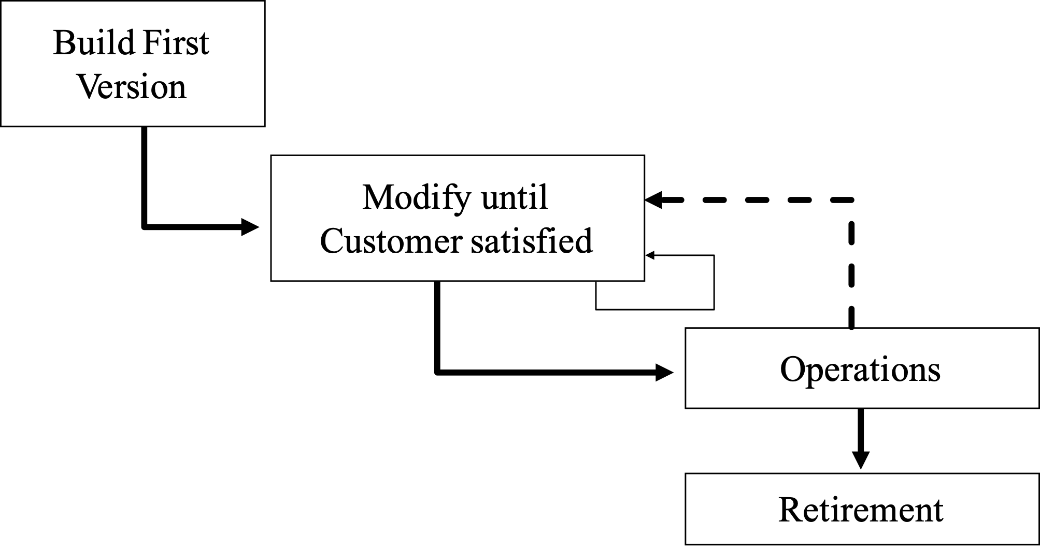
Software Processes
Code-and-fix
Really Bad
Really Common
Advantages
No Overhead
No Expertise
Disadvantages
No means of assessing progress
Difficult to coordinate multiple programmers
Useful for “hacking” single-use/personal-use programs: start with empty program and debug until it works

Slide 8
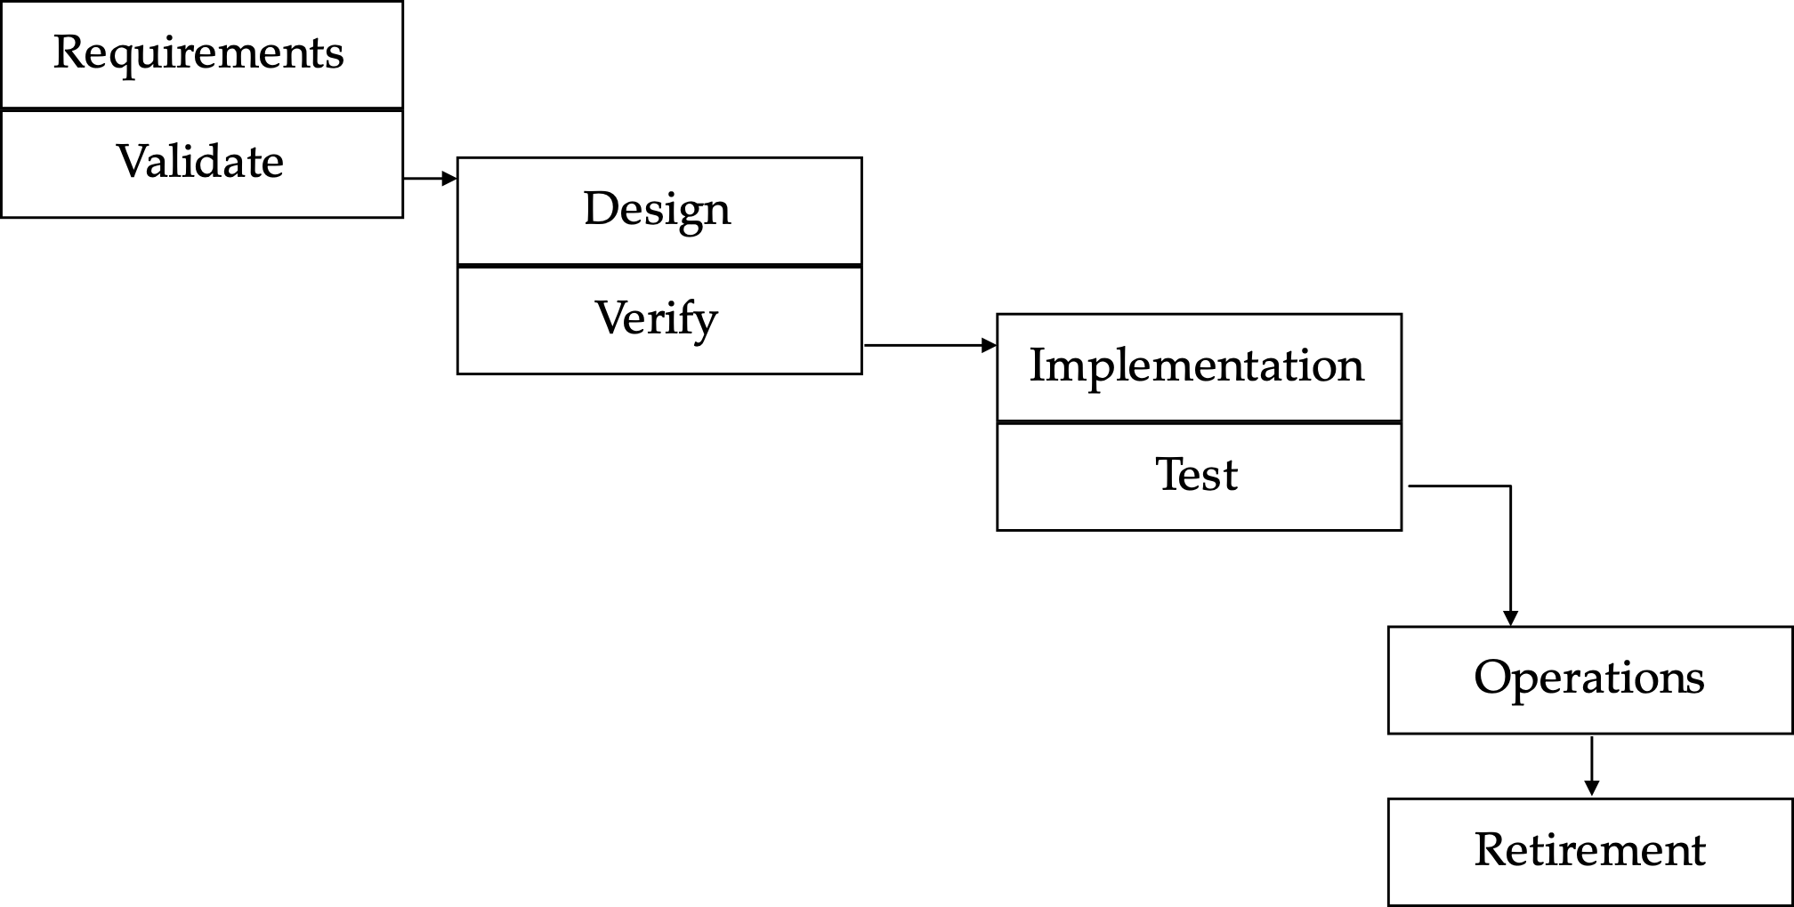
Software Processes
Waterfall Model
Widely used today
Advantages
Measurable progress
Experience applying steps in past projects can be used in estimating duration of “similar” steps in future projects
Produces software artifacts that can be re-used in other projects
Disadvantages
Difficulty of accommodating change after the process is underway: One phase has to be complete before moving onto the next phase.

Slide 9
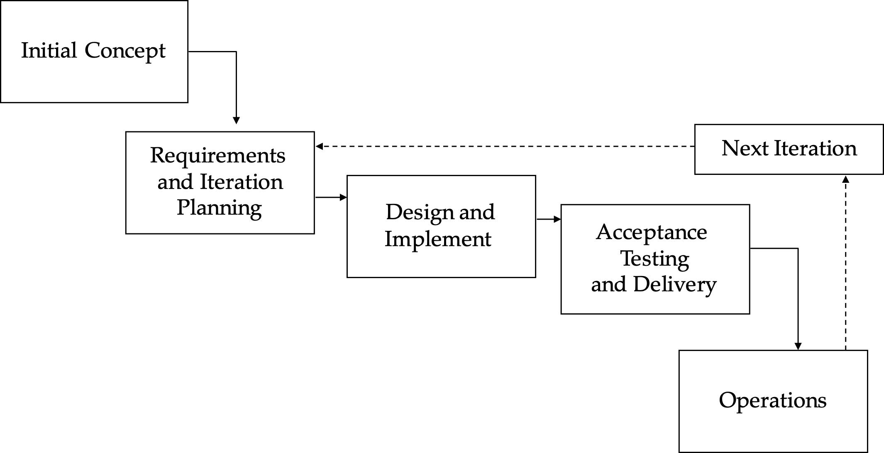
Software Processes
Agile Model
Agile results in an iterative model, where each iteration is several weeks long and results in several features being built
Recognize that requirements ALWAYS evolve as you are trying to build something
Plus, maybe you can get useful feedback by delivering a partial app early

Slide 10
Cost to Fix a Defect Over Time
Rough Estimate
“Shift Left” - find defects earlier in software lifecycle
Notes:
Why expensive as move to the right?
Need to be triaged by someone who doesn’t know (or doesn’t remember)
Might now need more work, since code has changed around the bug
Has a greater impact - who wants to read about their bug on the front page of the newspaper?

Slide 11
Software Processes
Continuous Development
Like agile, but…
Fast feedback loops
We have a formal mechanism for deploying new versions of code and validating (test/staging/production)
Develop
Build
Test
Deploy
Monitor
Notes:
Continuous development represents a process like agile, but distinguished by frequent feedback, which aims to help us to “shift left”. Whereas in a traditional development process, we might integrate all of our changes and perform end-to-end tests (and deployments) on a weekly or monthly basis, continuous development argues for faster feedback loops: integrate your code hourly and deploy multiple times a day.

Slide 12
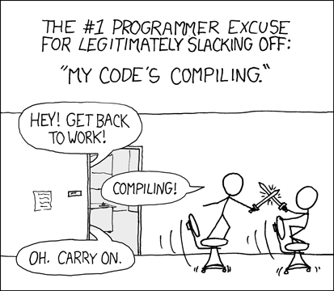
Why Continuous Development?
Unblocking developers and increasing velocity

Slide 13
Why Continuous Development?
Improving the end-user experience
1 5 10 100 1,000
If you have:
developers working on your product
Bug fixes
Security patches
Feature enhancements
New features
How often can you deliver your customers:

Slide 14
Continuous Development
Improving quality & velocity with frequent, fast feedback loops
Develop
Build
Test
Deploy
Monitor
Code Review
Style Check
Integration Test
End-to-end Test
KPIs
Compile
Load Test
Unit Test
Prepare Deployment
Notes:
Continuous development aims to help us achieve better code quality (fewer bugs, or at least reduce their impact) and development velocity (get features out to customers faster) by creating frequent, fast feedback loops at each stage of the development process. Continuous development encourages us to perform frequent integrations, merging changes into our entire codebase, and running integration-scale tests frequently. Key to continuous development is frequent integration and deployment of our product - topics that we’ll cover in subsequent lessons this week.

Slide 15
Roadmap for this week
Continuous development overview (this lesson)
“Shifting left” with continuous integration
Deployment infrastructure
Continuous delivery
Develop
Build
Test
Deploy
Monitor

Slide 16
This work is licensed under a Creative Commons Attribution-ShareAlike license
This work is licensed under the Creative Commons Attribution-ShareAlike 4.0 International License. To view a copy of this license, visit http://creativecommons.org/licenses/by-sa/4.0/
You are free to:
Share — copy and redistribute the material in any medium or format
Adapt — remix, transform, and build upon the material
for any purpose, even commercially.
Under the following terms:
Attribution — You must give appropriate credit, provide a link to the license, and indicate if changes were made. You may do so in any reasonable manner, but not in any way that suggests the licensor endorses you or your use.
ShareAlike — If you remix, transform, or build upon the material, you must distribute your contributions under the same license as the original.
No additional restrictions — You may not apply legal terms or technological measures that legally restrict others from doing anything the license permits.

